Slide 1


“AGR0 360”
CORE COURSE PROJECT
TEAM ID
Nedesh kumar M
2nd AIDS-CITAR
Surryaprasanna RD
2nd AIDS-CITAR
Dept of AI & DS
Chennai Institute of Technology, Chennai - 69

Slide 2
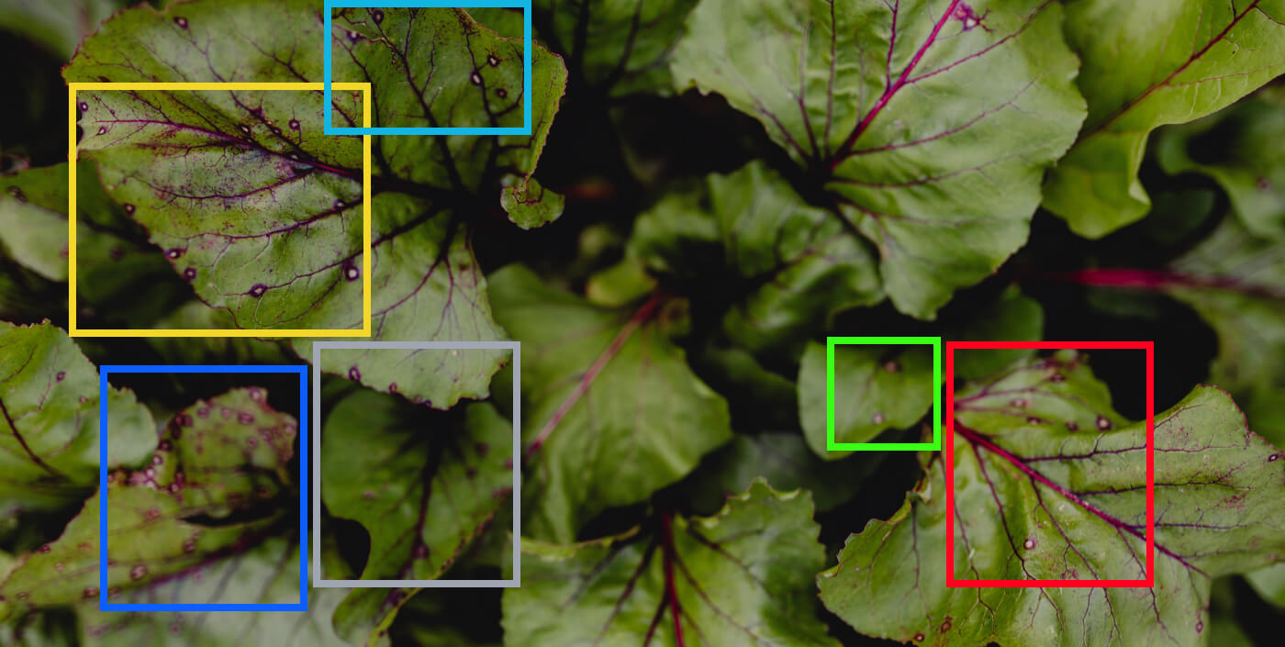
AGRO360: AI-Powered Plant Health Diagnosis
Bringing Innovation to Agriculture
AGRO360 is an AI-powered platform that detects plant diseases from images, addressing the $220B yearly losses due to plant diseases. Our vision empowers farmers with instant, data-driven insights for a food-secure future.

Slide 3

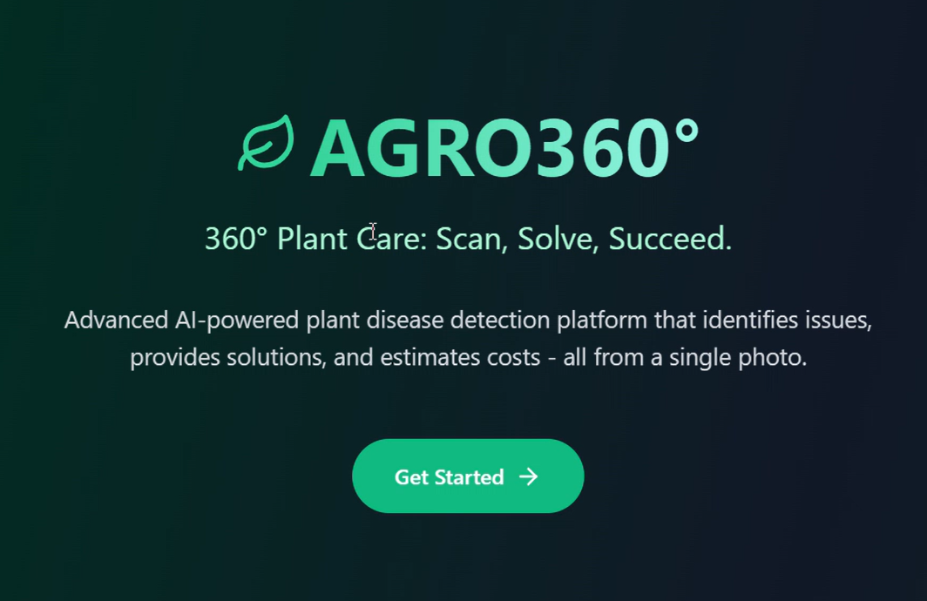




How AGRO360 Works
Upload Plant Image
User takes a photo of the affected crop.
AI Detects Disease
CNN Model analyzes patterns and
identifies disease.
Find the Cause
Analyzes environmental and biological factors.
Treatment Options
Organic & inorganic solutions provided.
Estimate Costs
Predicted price for treatment & prevention.

Slide 4



The Tech Behind AGRO360
Machine Learning Model
API Integration
Web Development
CNN trained on extensive plant disease datasets.
Gemini API for real-time image processing.
HTML, CSS, JavaScript (Frontend). Node.js, Express (Backend).

Slide 5
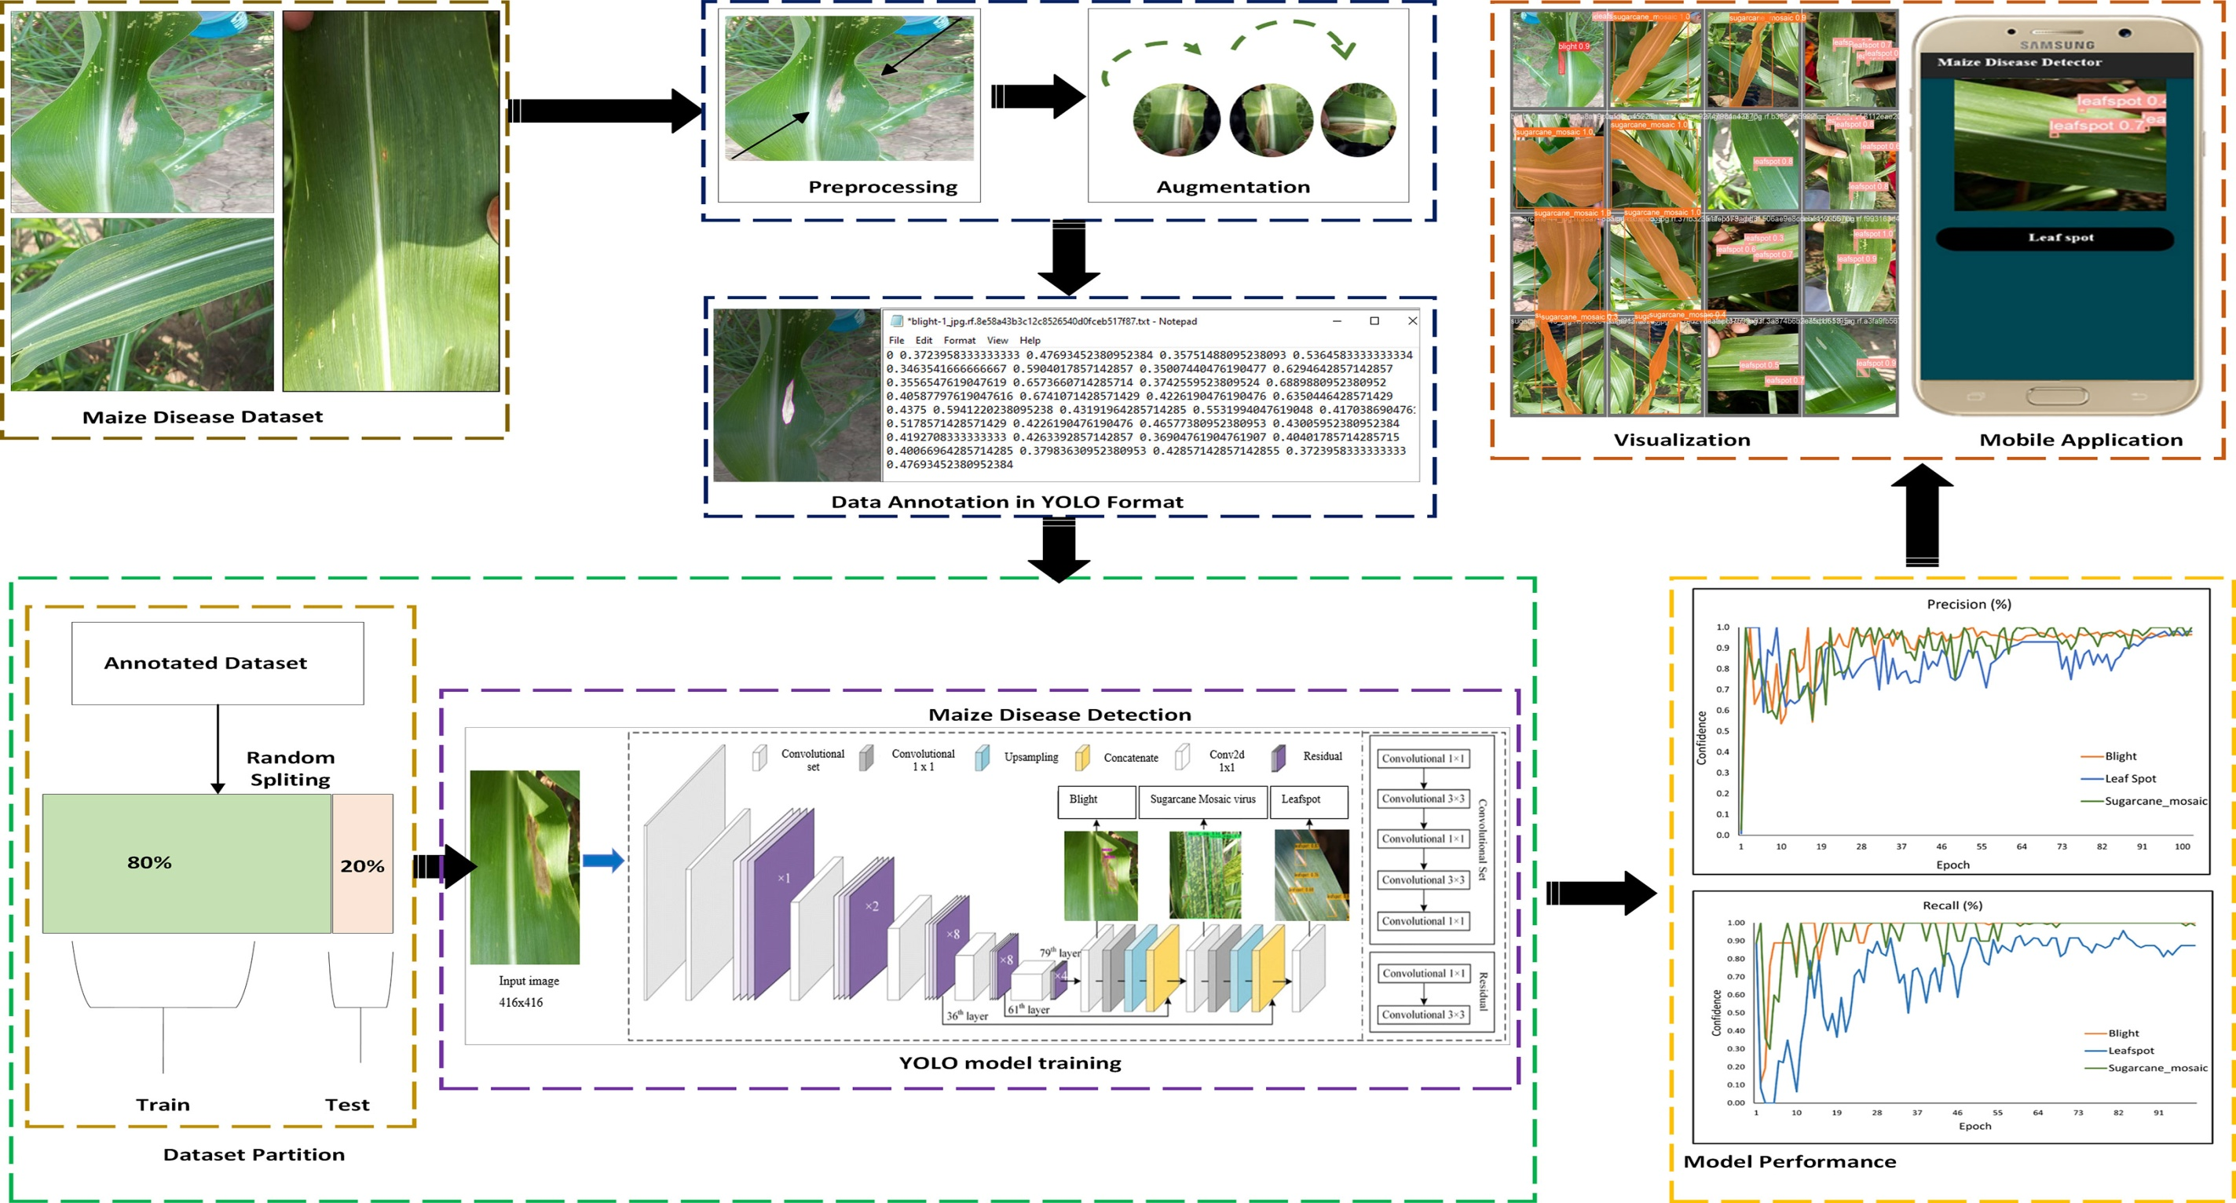

Slide 6
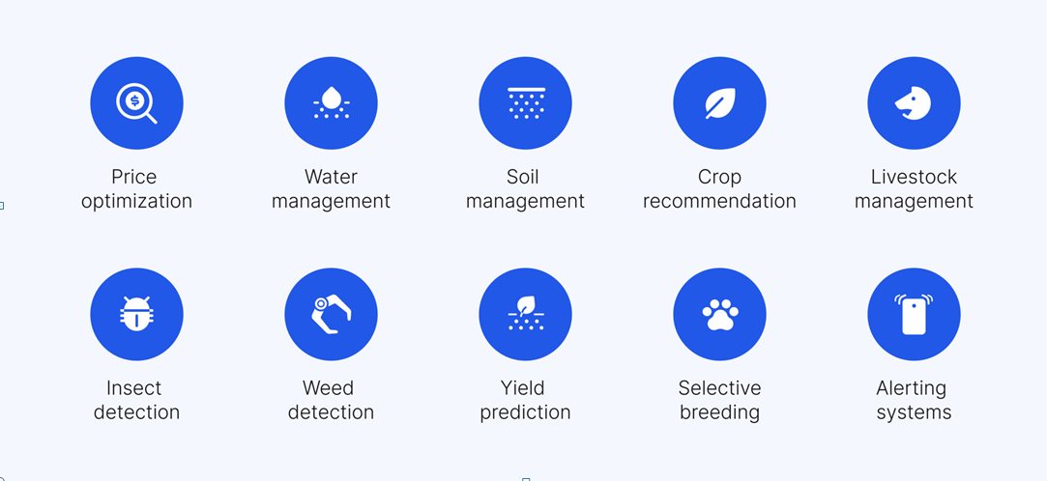
Future improvements

Slide 7

NedeshKumar M
(Nedeshkumarm.aids2023@citchennai.net)
Surryaprassana R D
(suryaprasannard.aids2023@citchennai.net)

